Slide 1
WEGU
COVID-19 Updates
April 13th, 2020
Emidio Di Meo

Slide 2
COVID-19 Resources
Federal Government:
https://www.canada.ca/en/public-health/services/diseases/2019-novel-coronavirus-infection.html
Provincial Government:
https://www.ontario.ca/page/government-ontario
Self Assessment:
https://covid-19.ontario.ca/self-assessment/#q0

Slide 3
WEGU Will Begin Weekly Work Station touch Point Disinfecting
JAN PRO has been hired to disinfect work stations and touch points
Jan-Pros EnviroShield system uses a disinfectant that is EPA-rated as the safest in its class
EnviroShield is able to kill 99.9% of harmful bacteria, including MRSA, H1N1, E. Coli, Listeria and covid-19
Jan-Pro will be on site every Monday at 6:00am
Please see additional Safety Data Shield posted at the bulletin boards

Slide 4
North American Automotive Companies Updates
2k Target Start Up May 4th, 2020
Note: We are revisiting weekly and will revise.

Slide 5
WEGU Covid-19 Task Team
John Shelley
Angie Lowe
Sinisa Vasic
Ian Thomson
Emidio Di Meo
**Please address all questions to one of the Covid-19 Task Team members

Slide 6
“WE ARE RESPONSIBLE FOR EACH OTHERS HEALTH”
We each must do our part and follow proper procedures
Proper and Regular Hand Washing
Social Distancing

Slide 9
Ontario Enacts Declaration of Emergency to Protect the Public
Significantly Enhanced Measures will Help Contain Spread of COVID-19
March 17, 2020 9:13 A.M.
TORONTO - Today, the Government of Ontario announced that it is taking decisive action by making an order declaring an emergency under s 7.0.1 (1) the Emergency Management and Civil Protection Act. In doing so, Ontario is using every power possible to continue to protect the health and safety of all individuals and families.
"We are facing an unprecedented time in our history," said Premier Ford. "This is a decision that was not made lightly. COVID-19 constitutes a danger of major proportions. We are taking this extraordinary measure because we must offer our full support and every power possible to help our health care sector fight the spread of COVID-19. The health and wellbeing of every Ontarian must be our number one priority."
As a result of this declaration and its associated orders, the following establishments are legally required to close immediately:
All facilities providing indoor recreational programs;
All public libraries;
All private schools as defined in the Education Act;
All licensed child care centres;
All bars and restaurants, except to the extent that such facilities provide takeout food and delivery;
All theatres including those offering live performances of music, dance, and other art forms, as well as cinemas that show movies; and
Concert venues.

Slide 10
Ontario Enacts Declaration of Emergency to Protect the Public
Significantly Enhanced Measures will Help Contain Spread of COVID-19
March 17, 2020 9:13 A.M.
Further, all organized public events of over fifty people are also prohibited, including parades and events and communal services within places of worship. These orders were approved by the Lieutenant Governor in Council and will remain in place until March 31, 2020, at which point they will be reassessed and considered for extension, unless this order is terminated earlier.
"We are acting on the best advice of our Chief Medical Officer of Health and other leading public health officials across the province," said Christine Elliott, Deputy Premier and Minister of Health. "We know these measures will affect people's every day lives, but they are necessary to ensure that we can slow the spread of COVID-19 and protect our people. We're working with all partners across the system, from public health to hospitals and community care, to do everything we can to contain this virus and ensure that the system is prepared to respond to any scenario."
"Our government is taking an important step to protect Ontarians by declaring a provincial emergency through the Emergency Management and Civil Protection Act, establishing Ontario's ability to quickly implement and enforce orders in the public interest," said Solicitor General Jones. "Our government will continue to respond to this outbreak by limiting the exposure of individuals to COVID-19 and ensure the health and well-being of all Ontarians."

Slide 11
The purpose of Social Distancing:
Stop the spike of the virus spread and reduce workload on Healthcare system. Hence, “flatten the Curve”
Social distancing is an approach to limiting the spread of an illness in the population by creating physical space between people and reducing the size of large gatherings, or avoiding them altogether.
The CDC (Center for Disease and Control) recommends everyone wash their hands frequently, keep a physical distance of 6 feet or more between yourself and anyone coughing or sneezing, and continue not touching your face.

Slide 12
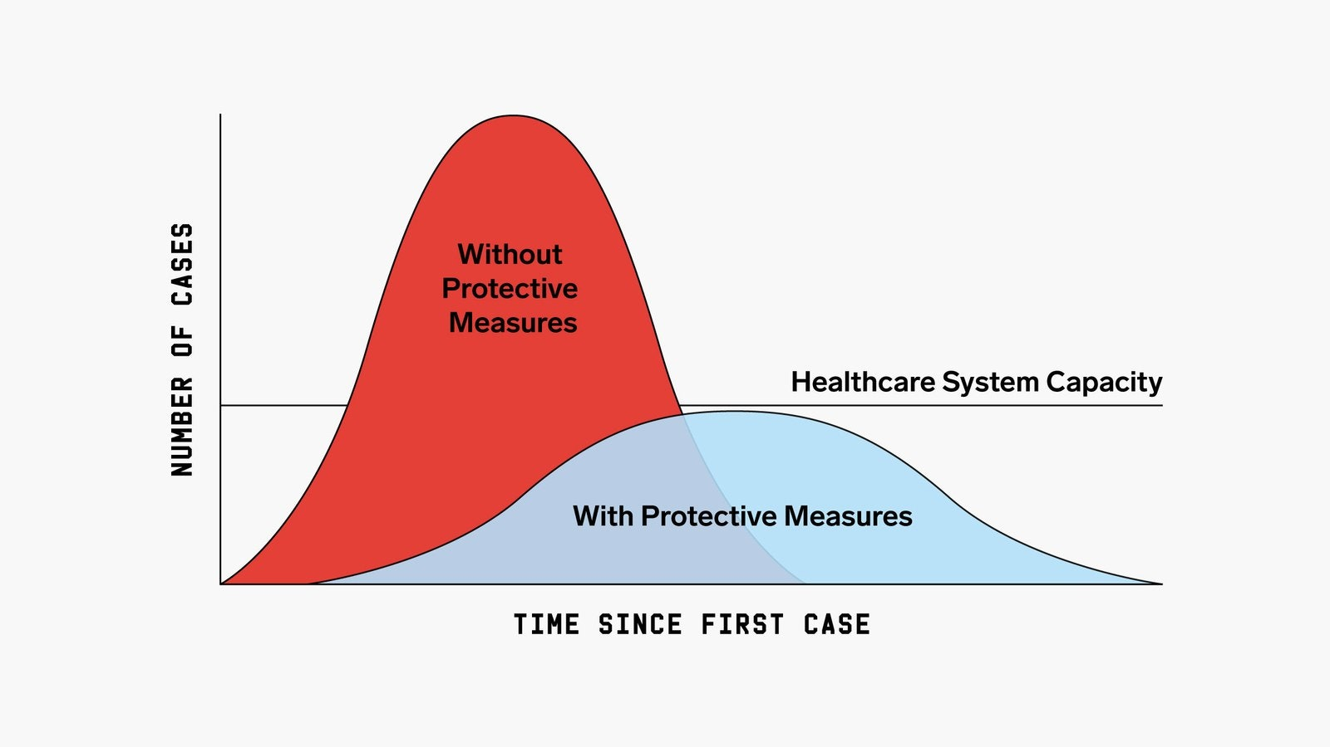
Flattening The Curve

Slide 13
Risk to Canadians per Federal Government Website
At this time, the public health risk associated with COVID-19 is low for the general population in Canada but this could change rapidly. There is an increased risk of more severe outcomes for Canadians:
aged 65 and over
with compromised immune systems
with underlying medical conditions
There are also increased health risks for Canadian travelers abroad. Because of these risks, the Government of Canada advises you to avoid non-essential travel outside of Canada until further notice, this includes cruise ships.
It is important for all travelers to:
Self-isolate for 14 days after your return from travel outside of Canada
some provinces and territories may have specific recommendations for certain groups such as health care workers
Monitor your health for fever, cough or difficulty breathing
Wash your hands often for 20 seconds and cover your mouth and nose with your arm when coughing or sneezing.

Slide 14
WEGU Actions To Help “Flatten the Curve”
Regular Employee Communication
Information and updates will be based on Federal Government Health website
WEGU in Contact with Provincial and Federal government
MPP Lorne Coe
MP Ryan Turnbull

Slide 15
WEGU Actions To Help “Flatten the Curve”
3. Follow Ontario Government Protocol: Cleaning and Sanitation
Hand washing soap and water for 20 seconds
If not feeling well, complete self-assessment( Ontario Gov web site)
Flu like symptoms'
Personal Workspace sanitation
Increase hand sanitation stations in the Plant

Slide 16
WEGU Actions To Help “Flatten the Curve”
4. Social Distancing
Eliminate large gatherings, meetings
Daily Production Meeting deferred. John will co-ordinate with individuals
Lunch room- employees should not sit next to each other
Stagger lunch areas- more details to follow
Clean door knobs and other common areas prone to human interaction
Separate employee work stations, increase personal space

Slide 17
WEGU Actions To Help “Flatten the Curve”
5. No visitors
No outside visitors
Until further notice and will revisit every two weeks.
Post sign-Front entrance
All doors are secured.
Truck Drivers protocol-JS/Michelle
Immediately Truck drivers cannot wander in the plant. Must stay in authorized area.

Slide 18
WEGU Actions To Help “Flatten the Curve”
6. No customer visits Until Further Notice
We will utilize skype, GO To Meetings and other forms of communication

Slide 19
WEGU Actions To Help “Flatten the Curve”
7. If employee leaves Canada, upon return must go into self-isolation for 14 days

